Slide 1

Global Health
2012
2012

Slide 2
June 26: This Course
Introduction of Faculty
Results of student survey
Role of Internet searching, with practice hooking up
Assignment of working groups
Questions

Slide 3
Epidemiology of Health and Disease
What is Health and Who Should Have It? (Case definition for Health)
Measuring Health and Disease: Where and When Are They Found?
Disease Surveillance
Health Statistics
Surveys

Slide 4
June 28
Determinants of Health and Disease
War
Economics
Climate
Transportation and Communication
Education
Health Care and Immunization
Sanitation
Food
Genetics

Slide 5
July 3:
The Players
Governments
International Organizations
Corporations, including pharmaceutical companies
Non-governmental Organizations (NGO’s)
Health Care Systems

Slide 6
University of Miami Panel
International Projects at UM
Living and Working Outside the US
Professional Licensing
Human Subjects Research and Institutional Review Boards
Ethical and Public Relations Concerns—How to be an ugly American
Preparing for International Work—a visit or a career
Scary experiences, rewarding experiences
Driving, personal security, etc.
How did international experience change you?

Slide 7
Response to Natural and Manmade Disasters
Dr. Emmanuel D’Harcourt, International Rescue Committee (IRC)

Slide 8
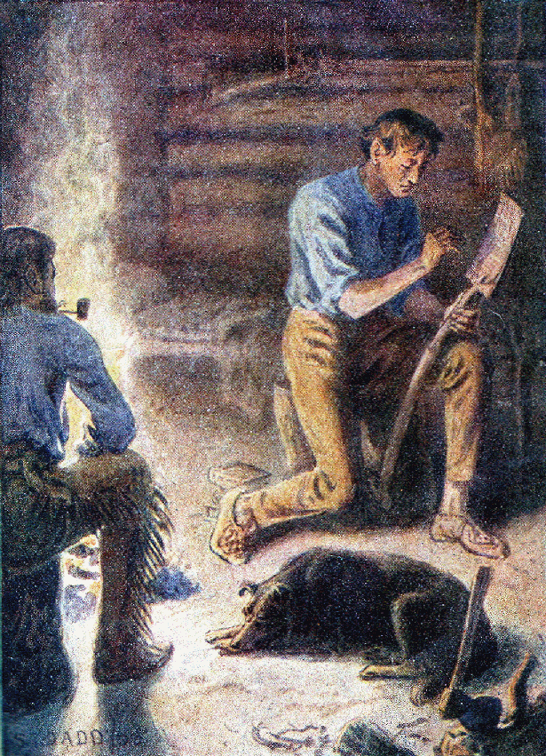
Energy and Health
Robert Freling, Solar Electric Light Fund(SELF)
Energy and Water
Energy and Indoor air
Energy and Health facilities
Energy and Food
Energy and Women’s Activities
Energy and Conservation / deforestation
Energy and Climate Change
Energy and Job Creation / Poverty
Energy production
Energy and transportation
Energy and communication / education

Slide 9
Evaluation of Interventions
If you were Bill Gates, and had a billion or two dollars to donate, where would it do the most good for global health?

Slide 10
Public Health Informatics and Record Keeping

Slide 11
Population; Nutrition

Slide 12
Injury, Environmental and Occupational Health

Slide 13
HIV and Tuberculosis
Consuelo Beck-Sagué, MD, FAAP

Slide 14
Malaria and Diarrheal Disease

Slide 15
Where do you want to go from here, and where should the world go?

Slide 16
References

